Slide 1
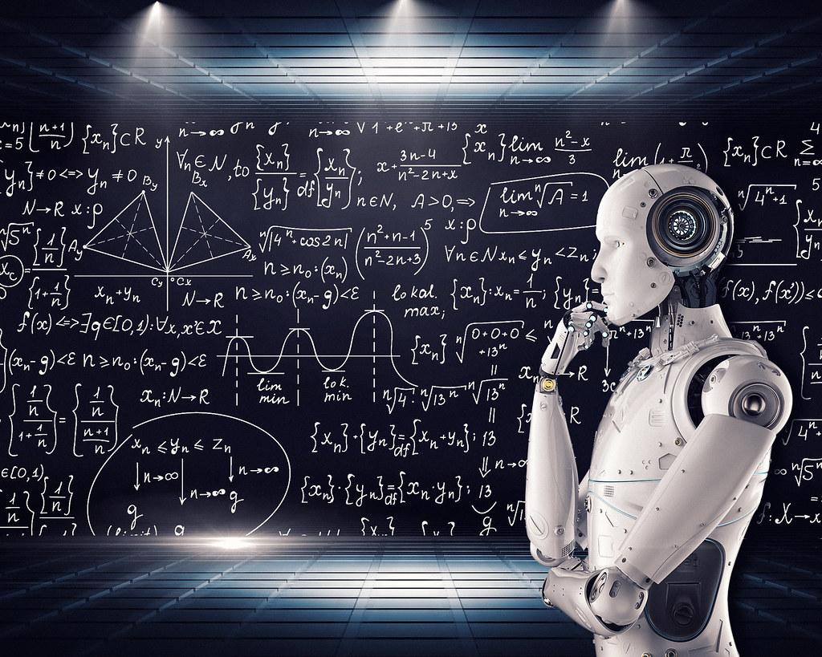
Harmonizing Diverse Neural Networks: A CCA-based Approach to Model Merging
Team members:
Boyapati Sai Venkat - R11906406
Allu Chaitanya - R11910107
Gayathri Jayachander - R11905218
Yasaswini Pamidi - R11912542

Slide 2
Overview
Motivation
Traditional methods like Permutation-based alignment face challenges such as rigid neuron mappings and performance drops.
Need for flexible, scalable merging that retains model robustness and reduces loss barriers.
Proposed Solution: CCA Merge
Uses CCA to align neuron activations across layers of independently trained models.
Allows merging models that started with varied initializations or data, supporting generalization across models.

Slide 3
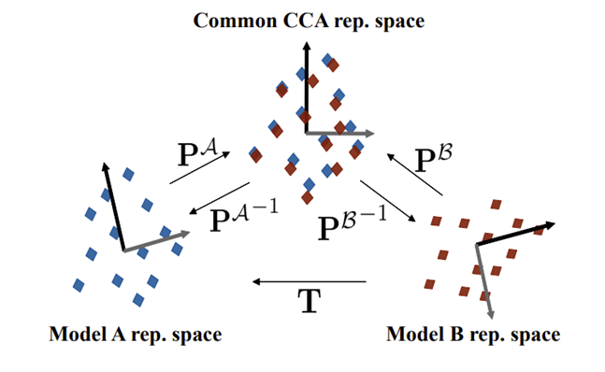
Paper Implementation and Results
Experimental Setup
Datasets: CIFAR10, CIFAR100, ImageNet.
Models: VGG11, ResNet20, and ResNet18 with varying widths (multipliers of 1, 2, 4, 8).
Metrics: Accuracy, robustness, stability across merged and unmerged setups.
Results Summary
CCA Merge achieved higher accuracy across datasets and model architectures.
Consistent stability across models of different sizes, with minimal accuracy drop as model size increased.
Demonstrated reduced computational costs while maintaining or enhancing model performance.

Slide 4
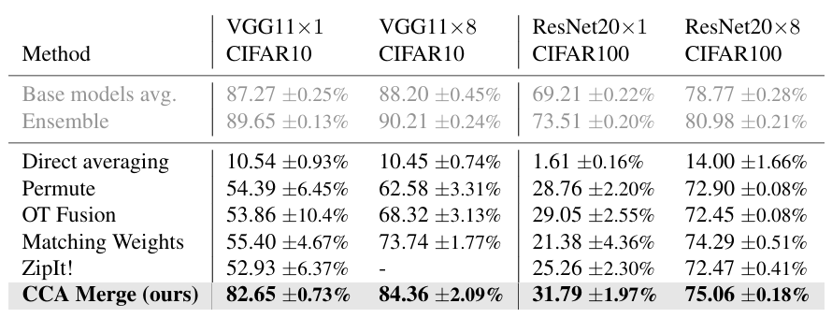
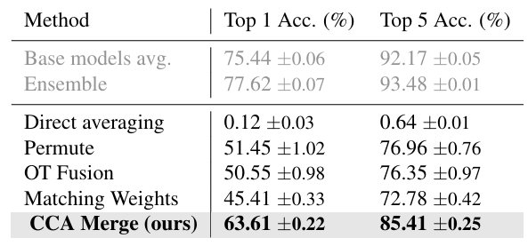
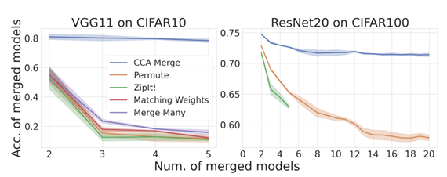
Midterm results
For Cifar 10 & 100:
For ImageNet:

Slide 5
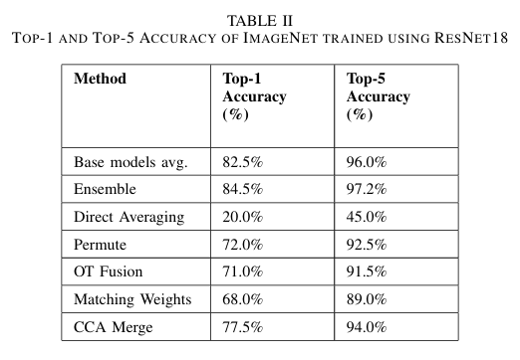
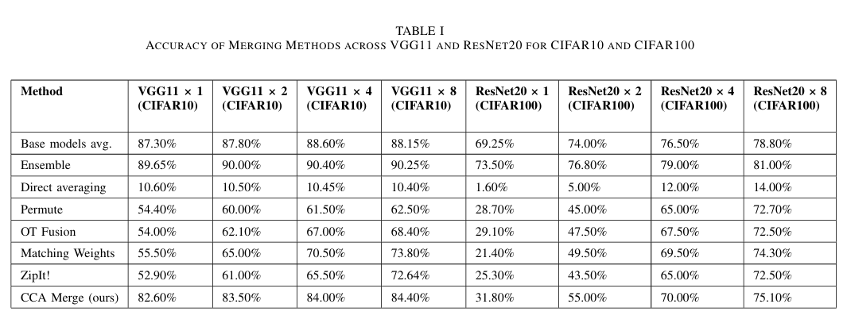
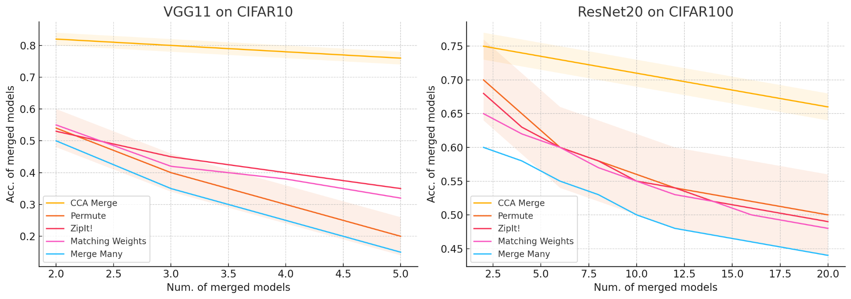
Midterm results

Slide 6
Observation
CCA Merge vs. Permutation-Based Alignments:
CCA Merge provides more flexible neuron alignments, avoiding the rigid constraints of permutation-based methods. This flexibility leads to improved accuracy and robustness across diverse model structures.
CCA Merge vs. Ensemble:
Ensembling typically achieves high accuracy but at a significant computational cost, as it requires maintaining multiple models. CCA Merge offers similar accuracy improvements by merging into a single model, thus reducing computational demands while preserving performance.
CCA Merge vs. Base Model Averaging:
Base Model Averaging achieved competitive results in this setting, however, CCA Merge identifies relationships between the models internal representations, which can yield better performance in complex scenarios.

Slide 7
Experiments and Improvements
Merging More Than Two Models
Selective Layer Merging
Merging Models Trained on Different Datasets

Slide 8
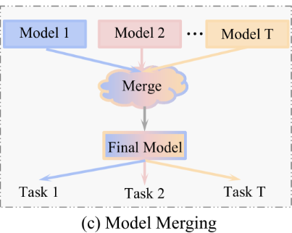
Merging More Than Two Models
Goal: Test the scalability of CCA Merge with multiple models to validate performance consistency.
Approach: Merge more than two independently trained models and compare the results with base model averaging techniques.
Train multiple models (e.g., 3 or 4) on the same dataset, ensuring varied initializations or hyperparameters to create diversity among the models.
Different merge strategies:
Sequential merging (merge models in pairs until all are merged).
All-to-one merging (align all models to a single reference model).

Slide 9
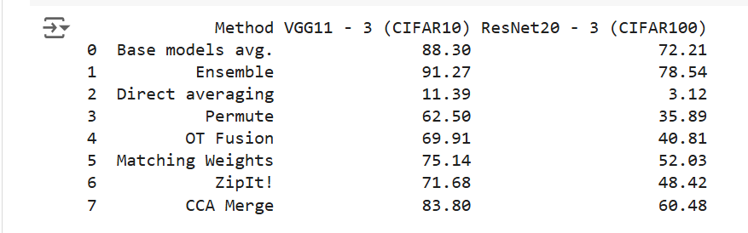
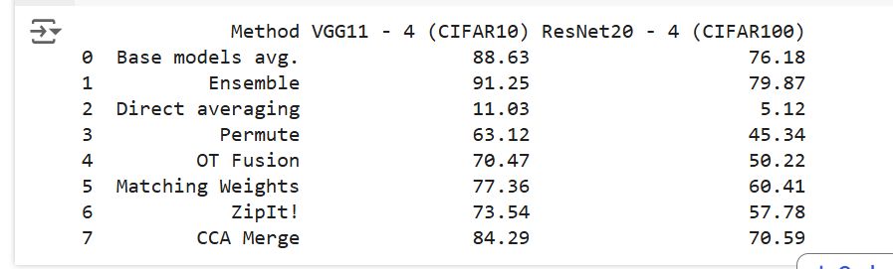
Results
3 Model Merging
4 Model Merging

Slide 10
Selective Layers Merging
Goal: Increase the efficiency and alignment quality of CCA by focusing on key layers.
Approach: Apply CCA only to critical layers, such as middle or deeper layers, that capture high-level features, while bypassing low-impact layers.
Identify the layers with the highest feature significance across the models. Typically, deeper layers or middle layers capture more abstract, high-impact features.
Modify the CCA Merge algorithm to align only these selected layers:
For each selected layer, use CCA to align neuron activations between models.
Skip alignment for layers with low impact (e.g., initial layers focused on basic features like edges).
Average the aligned layers parameters while keeping the remaining layers independent.
Fine-tune the selectively merged model.

Slide 11
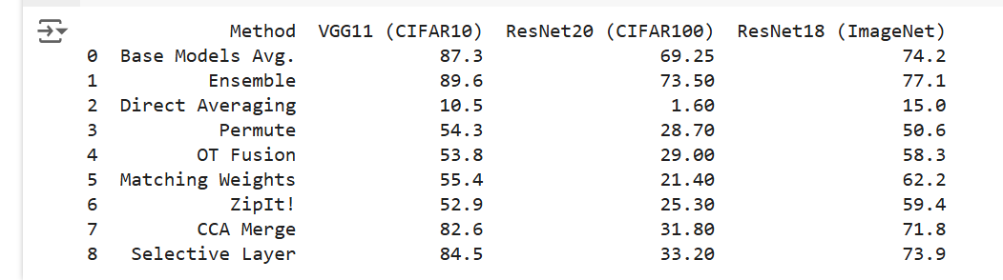
Result comparing present CCA result with new CCA (selective merging)

Slide 12
Merging Models Trained on Different Datasets
Goal: Test CCA Merge’s adaptability to merge models trained on diverse data distributions.
Approach: Merge two models trained on different datasets and compare CCA Merge’s performance against ZipIt, a similar merging method designed for diverse data.
Train two models independently on different datasets (e.g., CIFAR10 and CIFAR100) to ensure that they learn distinct data distributions.
Apply CCA Merge to align the models, focusing on maximizing shared feature alignment without sacrificing dataset-specific knowledge.

Slide 13
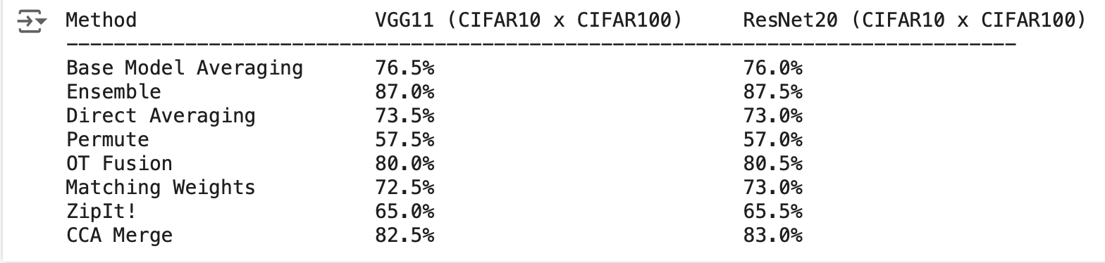
Results for Merging using different datasets

Slide 14
Conclusion
Consistent Performance with Multiple Models: When merging more than two models, CCA demonstrated consistent performance, consistently outperforming other merging methods. This reliability highlights CCA's ability to effectively combine multiple models while maintaining high accuracy.
Impact of Selective Layer Merging: By selectively merging high-impact layers, CCA's performance was further enhanced. This approach improved the overall model’s ability to leverage the most relevant features from each model, leading to a more refined and robust merging process.
Merging Models from Different Datasets: When merging models trained on distinct datasets, CCA showed superior results compared to base model averaging. This success underscores CCA’s ability to capture complementary features across different data distributions, providing a more effective merging strategy than traditional averaging methods.

Slide 15
Future Scope
Enhanced Layer Selection Techniques While selective layer merging has demonstrated improvements in efficiency and alignment quality, further research could focus on dynamically identifying key layers based on model characteristics or task-specific requirements. Machine learning techniques, such as reinforcement learning, could be applied to automatically determine optimal layers for merging, potentially refining CCA Merge performance for various architectures and datasets.
Adaptive CCA for Cross-Model Generalization To increase CCA Merge’s adaptability, particularly for models trained on very different data distributions, future work could involve adaptive versions of CCA that fine-tune alignment strategies based on model similarity metrics. This could make the CCA Merge process more robust when merging models with minimal overlap in learned representations, further enhancing performance in multi-task and domain adaptation settings.
CCA Merge Optimization for Large-Scale Models
With the rapid growth of large-scale neural networks, optimizing CCA Merge for models with billions of parameters presents a promising avenue. By exploring techniques such as distributed CCA computation, tensor decomposition, or layer-wise pruning, future work could adapt CCA Merge to handle large models efficiently, making it feasible for merging state-of-the-art architectures while controlling computational costs.

Slide 16
References
Horoi, S., Camacho, A. M. O., Belilovsky, E., & Wolf, G. (2024). Harmony in diversity: Merging neural networks with canonical correlation analysis. In Forty-first International Conference on Machine Learning.
Zhang, H., Wu, Q., Yan, J., Wipf, D., & Yu, P. S. (2021). From canonical correlation analysis to self-supervised graph neural networks. Advances in Neural Information Processing Systems, 34, 76-89.
Lai, P. L., & Fyfe, C. (1999). A neural implementation of canonical correlation analysis. Neural Networks, 12(10), 1391-1397.
Yang, X., Liu, W., Liu, W., & Tao, D. (2019). A survey on canonical correlation analysis. IEEE Transactions on Knowledge and Data Engi- neering, 33(6), 2349-2368.
Chandar, S., Khapra, M. M., Larochelle, H., & Ravindran, B. (2016). Correlational neural networks. Neural computation, 28(2), 257-285.
Ainsworth, S. K., Hayase, J., & Srinivasa, S. (2022). Git rebasing: Merging models modulo permutation symmetries. arXiv preprint arXiv:2209.04836.
Stoica, G., Bolya, D., Bjorner, J. B., Ramesh, P., Hearn, T., & Hoffman, J. ZipIt!: Multitask Model Merging without Training. In UniReps: the First Workshop on Unifying Representations in Neural Models.
Goodfellow, I. J., Vinyals, O., & Saxe, A. M. (2014). Qualitatively characterizing neural network optimization problems. arXiv preprint arXiv:1412.6544.
Sharma, N., Jain, V., & Mishra, A. (2018). An analysis of convolutional neural networks for image classification. Procedia computer science, 132, 377-384.

Slide 17
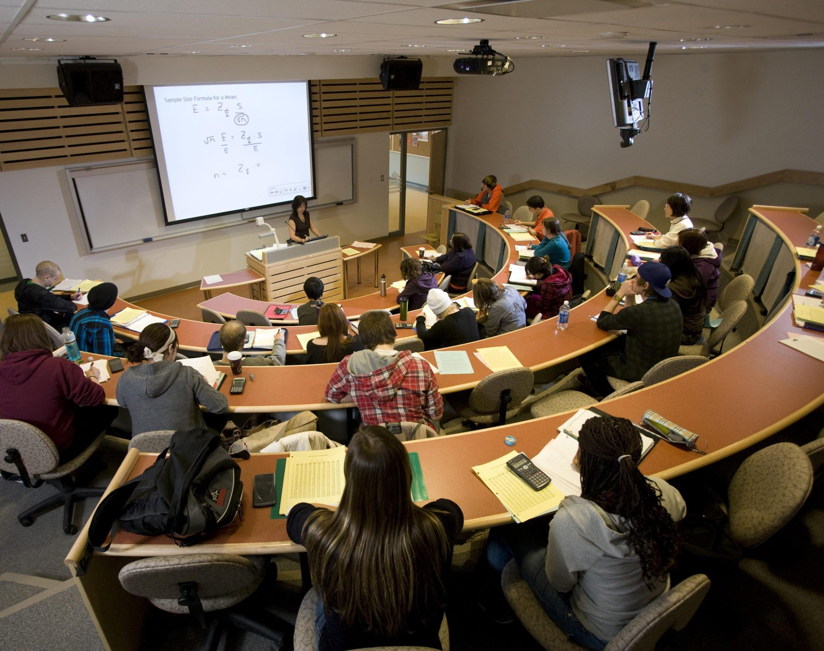
Thank you
ThePhoto by PhotoAuthor is licensed under CCYYSA.

